Slide 1
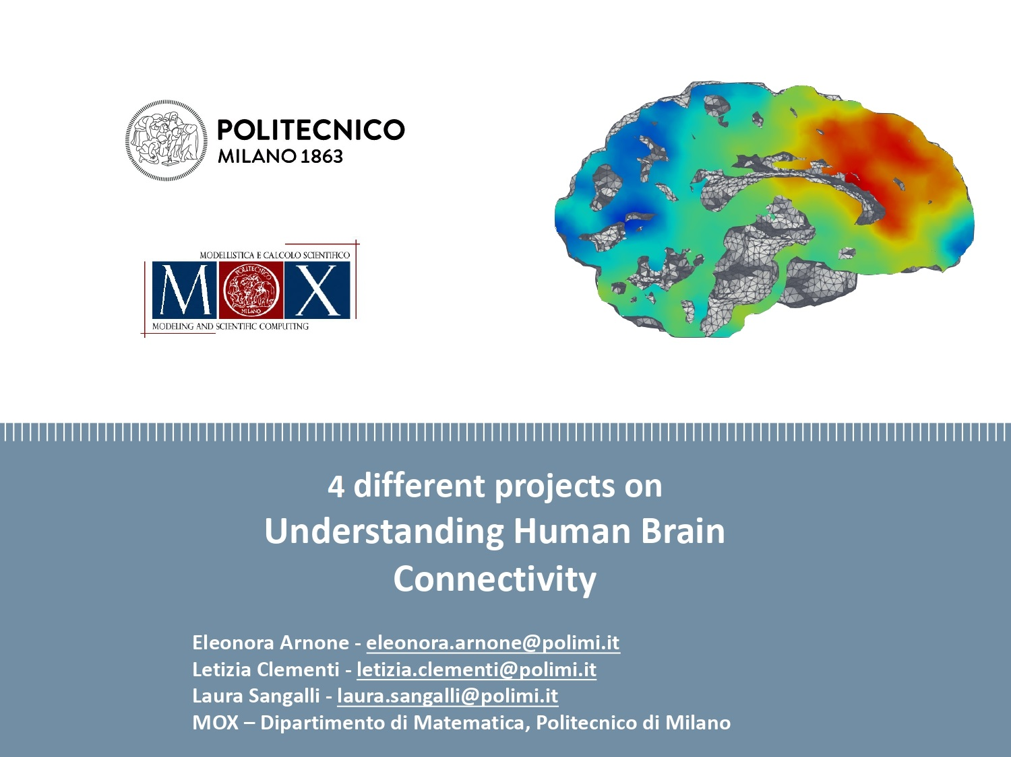

Slide 2
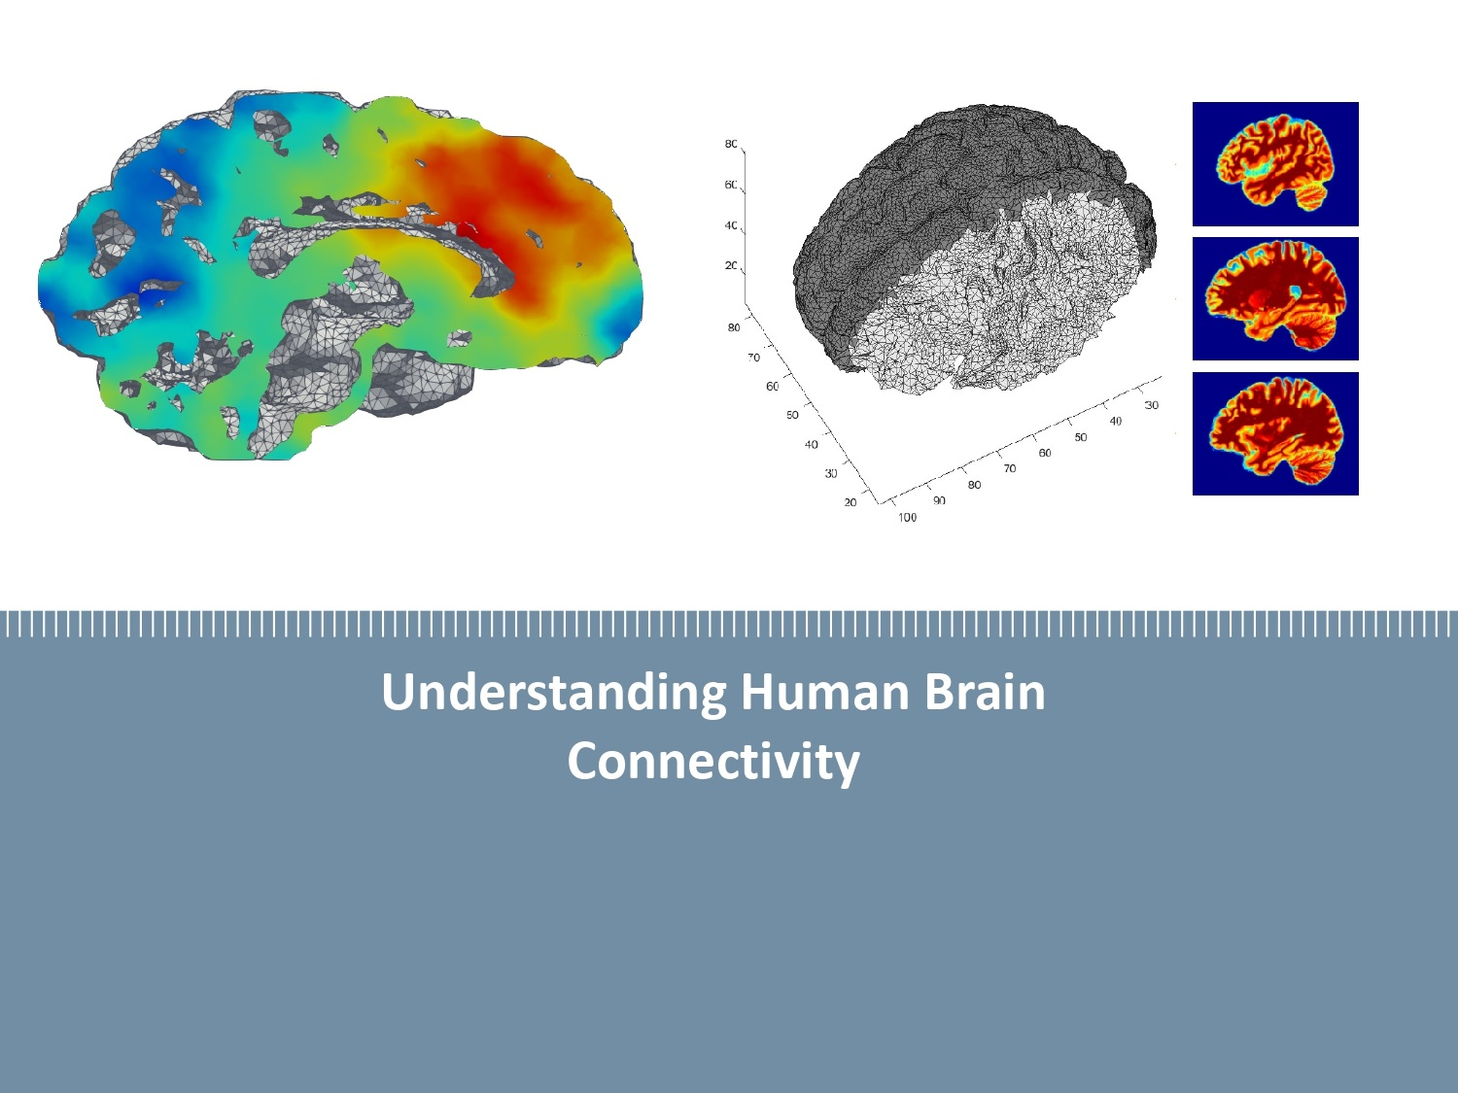
Costanza Cantalini, Erica Bistacchia, Lorenzo Ferrara, Scott Pesenti

Slide 3
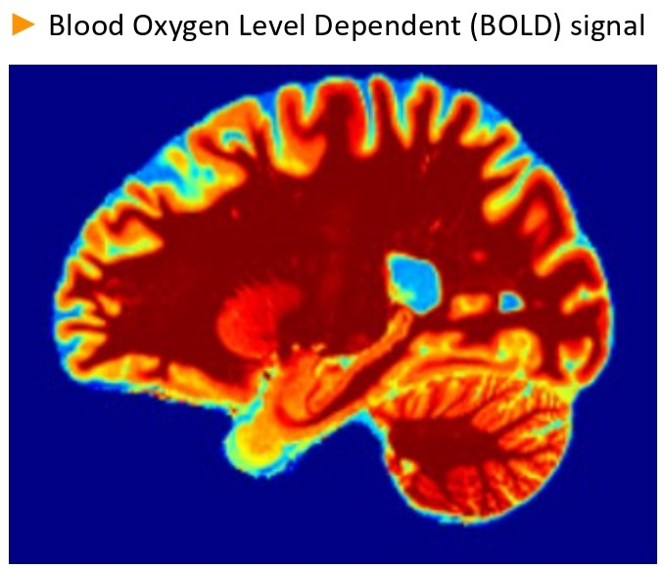
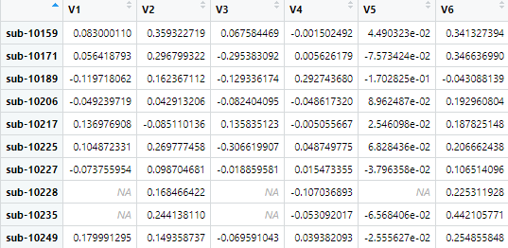
The connectivity map
Brains mapped on the same ATLAS
n° nodi
n° pazienti
3 patologie:
ADHD
BIPOLARISM
SCHIZOPHRENIA

Slide 4
Medical, psychological and demographic background of the subjects
We have information about the subjects' :
health conditions: …
smoking habits: …
cultural/ethnic identity: …
results of the Barratt's test: ...

Slide 5
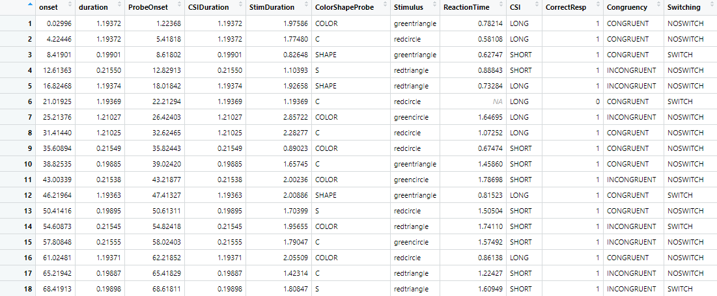
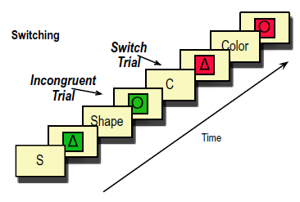
The task-switch experiment
96 trials in total
both switch and non switch trials
…
…

